Slide 1
Lecture 4: Backpropagation and Neural Networks
Lecture 4 - 1
Fei-Fei Li & Justin Johnson & Serena Yeung Lecture 4 - April 13, 2017

Slide 2
Administrative
Assignment 1 due Thursday April 20, 11:59pm on Canvas
Lecture 4 - 2

Slide 3
Administrative
Project: TA specialities and some project ideas are posted on Piazza
Fei-Fei Li & Justin Johnson & Serena Yeung
Lecture 3 -
3
April 11, 2017

Slide 4
Administrative
Google Cloud: All registered students will receive an email this week with instructions on how to redeem $100 in credits
Lecture 4 - 4

Slide 5
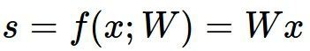
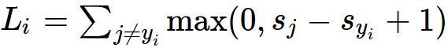
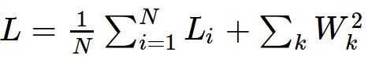
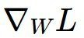
Where we are...
scores function
SVM loss
data loss + regularization
want
Lecture 4 - 4

Slide 6

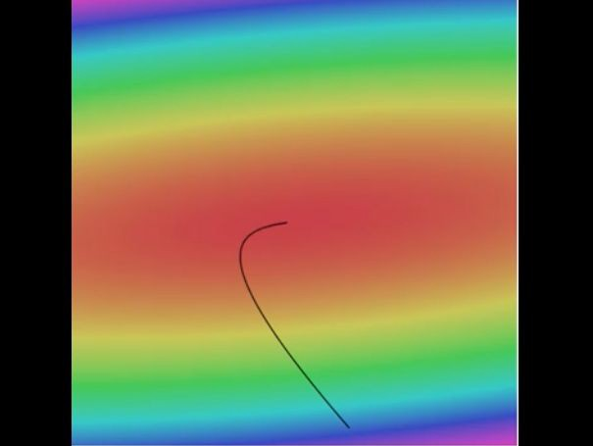

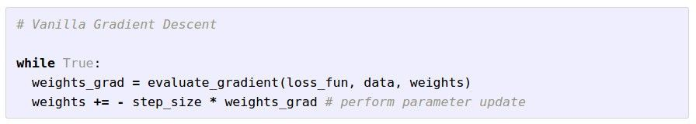
Optimization
Landscape image is CC0 1.0 public domain Walking man image is CC0 1.0 public domain
Lecture 4 - 4

Slide 7
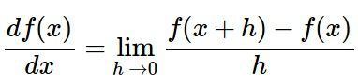
Gradient descent
Numerical gradient: slow :(, approximate :(, easy to write :)
Analytic gradient: fast :), exact :), error-prone :(
In practice: Derive analytic gradient, check your implementation with numerical gradient
Lecture 4 - 4

Slide 8
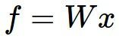
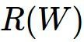
Computational graphs
x
*
s (scores)
hinge loss
+
L
W
R
Lecture 4 - 4

Slide 9
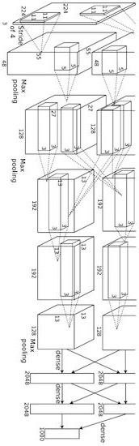
Convolutional network (AlexNet)
input image
weights loss
Figure copyright Alex Krizhevsky, Ilya Sutskever, and Geoffrey Hinton, 2012. Reproduced with permission.
Lecture 4 - 4

Slide 10
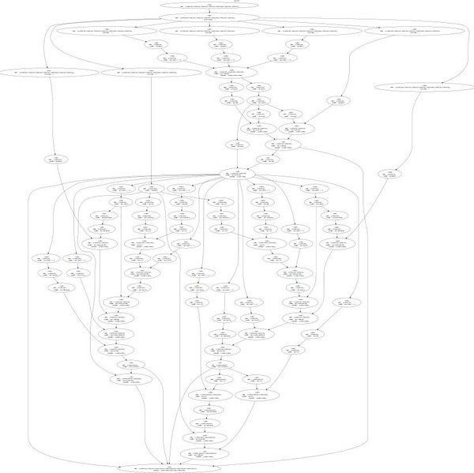
Neural Turing Machine
input image
loss
Figure reproduced with permission from a Twitter post by Andrej Karpathy.
Lecture 4 - 10

Slide 11
Neural Turing Machine
Figure reproduced with permission from a Twitter post by Andrej Karpathy.
Fei-Fei Li & Justin Johnson & Serena Yeung
Lecture 4 -
April 13, 2017

Slide 12
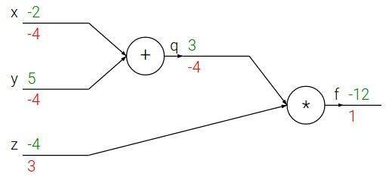
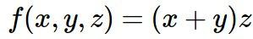
Backpropagation: a simple example
e.g. x = -2, y = 5, z = -4

Slide 13
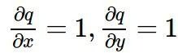
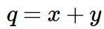
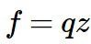
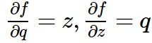
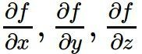
Backpropagation: a simple example
e.g. x = -2, y = 5, z = -4
Want:

Slide 14
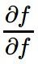
Backpropagation: a simple example
e.g. x = -2, y = 5, z = -4
Want:

Slide 15
Backpropagation: a simple example
e.g. x = -2, y = 5, z = -4
Want:

Slide 16
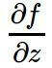
Backpropagation: a simple example
e.g. x = -2, y = 5, z = -4
Want:

Slide 17
Backpropagation: a simple example
e.g. x = -2, y = 5, z = -4
Want:

Slide 18
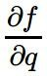
Backpropagation: a simple example
e.g. x = -2, y = 5, z = -4
Want:

Slide 19
Backpropagation: a simple example
e.g. x = -2, y = 5, z = -4
Want:

Slide 20
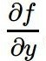
Backpropagation: a simple example
e.g. x = -2, y = 5, z = -4
Want:

Slide 21
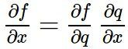
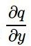
Backpropagation: a simple example
e.g. x = -2, y = 5, z = -4
Chain rule:
Want:

Slide 22
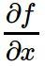
Backpropagation: a simple example
e.g. x = -2, y = 5, z = -4
Want:

Slide 23
Backpropagation: a simple example
e.g. x = -2, y = 5, z = -4
Chain rule:
Want:

Slide 24
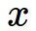
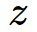
f

Slide 25
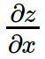
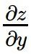
“local gradient”
f

Slide 26
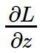
“local gradient”
f
gradients

Slide 27
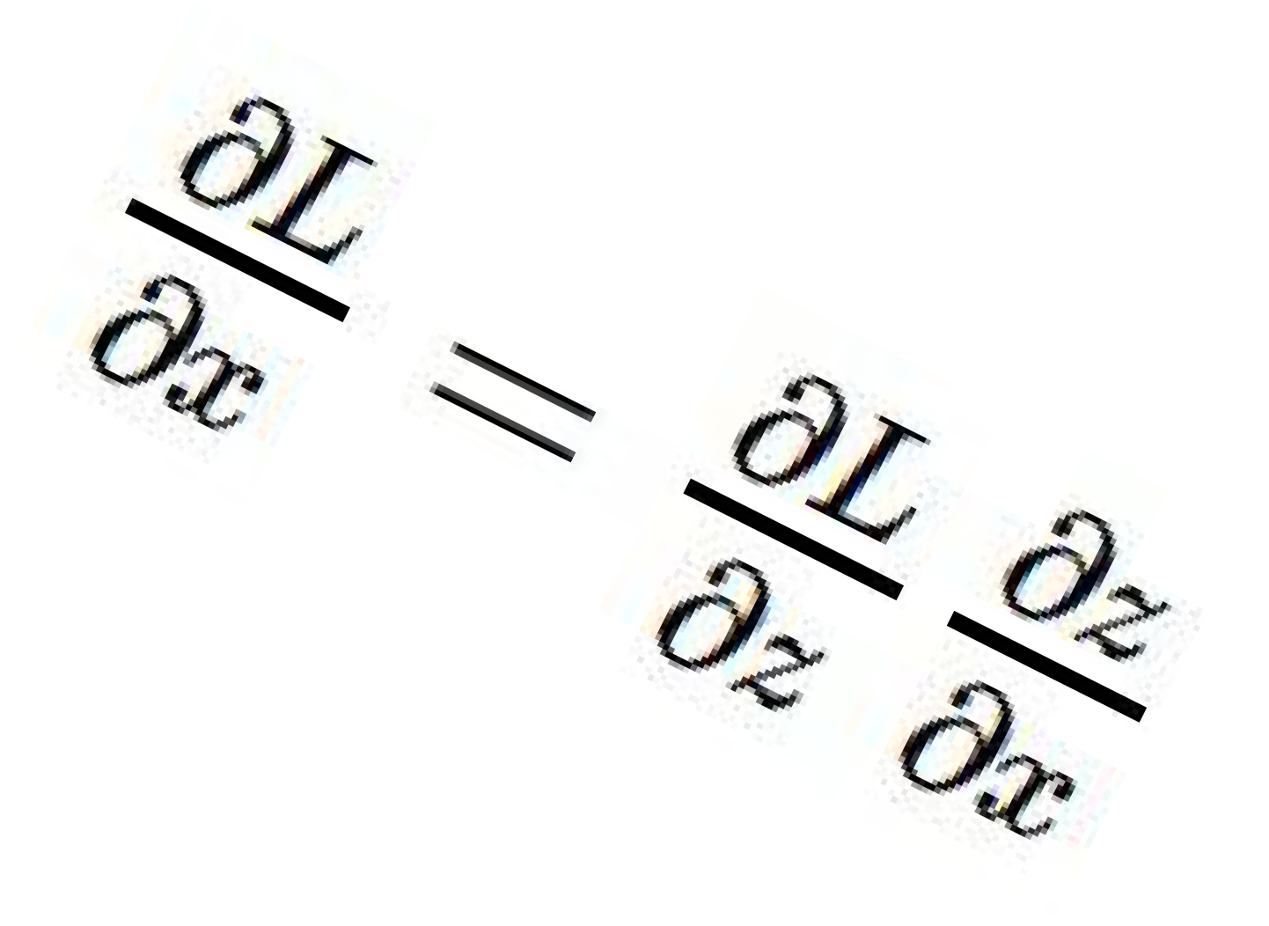
“local gradient”
f
gradients

Slide 28
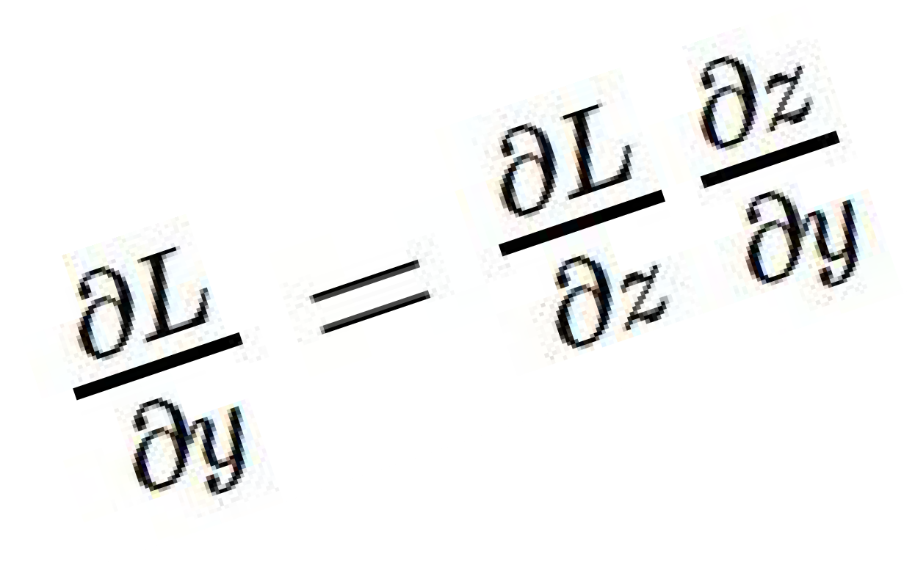
“local gradient”
f
gradients

Slide 29
“local gradient”
f
gradients

Slide 30
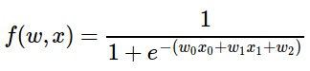
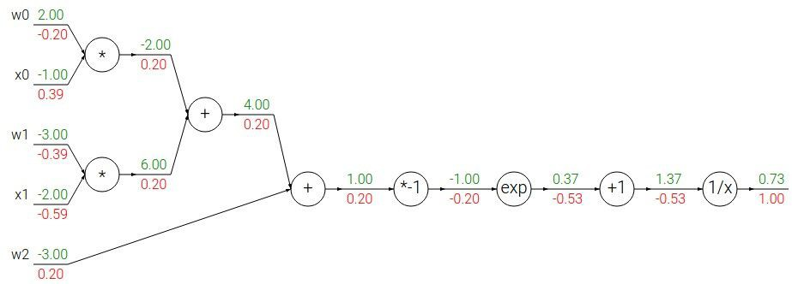
Another example:

Slide 31
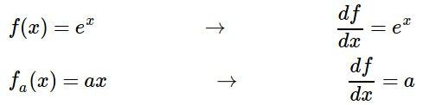
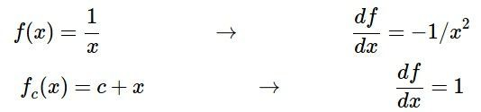
Another example:

Slide 32
Another example:

Slide 33
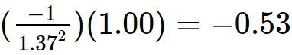
Another example:

Slide 34
Another example:

Slide 35
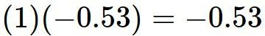
Another example:

Slide 36
Another example:

Slide 37
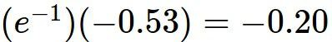
Another example:

Slide 38
Another example:

Slide 39
Another example:
(-1) * (-0.20) = 0.20

Slide 40
Another example:

Slide 41
Another example:
[local gradient] x [upstream gradient] [1] x [0.2] = 0.2
[1] x [0.2] = 0.2 (both inputs!)

Slide 42
Another example:

Slide 43
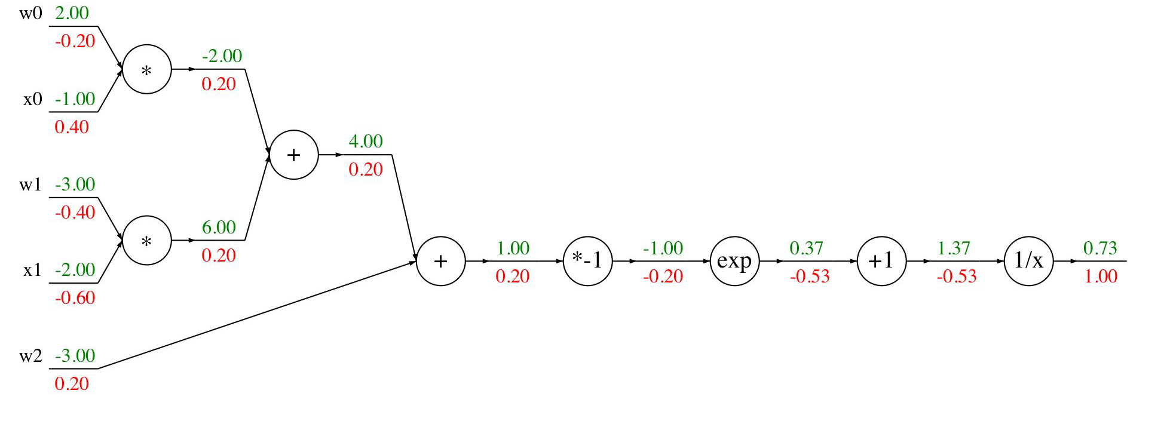
Another example:
[local gradient] x [upstream gradient] x0: [2] x [0.2] = 0.4
w0: [-1] x [0.2] = -0.2

Slide 44
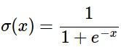
sigmoid function
sigmoid gate

Slide 45
sigmoid function
sigmoid gate
(0.73) * (1 - 0.73) = 0.2

Slide 46
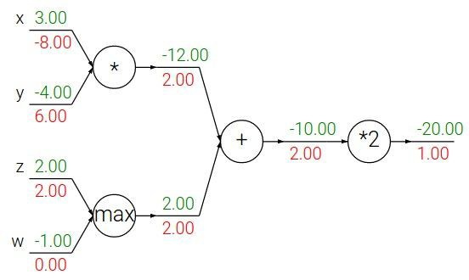
Patterns in backward flow
add gate: gradient distributor

Slide 47
Patterns in backward flow
add gate: gradient distributor Q: What is a max gate?

Slide 48
Patterns in backward flow
add gate: gradient distributor
max gate: gradient router

Slide 49
Patterns in backward flow
add gate: gradient distributor
max gate: gradient router Q: What is a mul gate?

Slide 50
Patterns in backward flow
add gate: gradient distributor max gate: gradient router mul gate: gradient switcher

Slide 51
Gradients add at branches
+

Slide 52
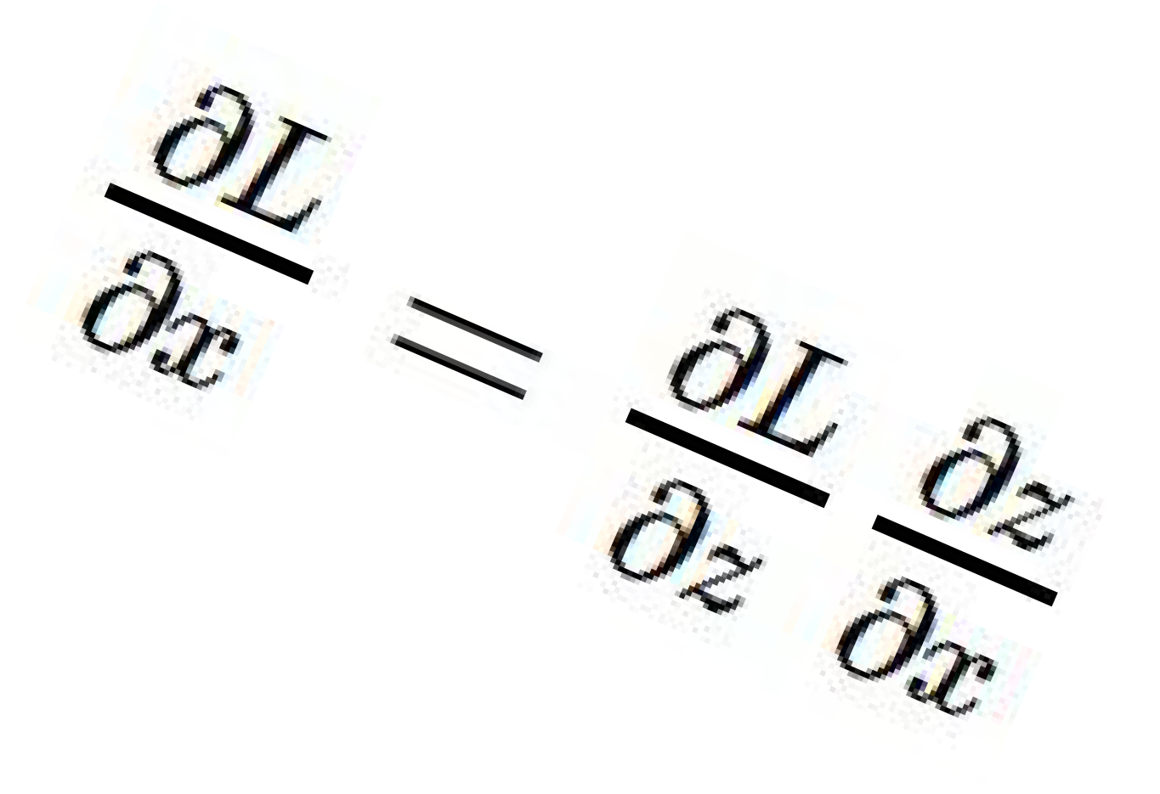
Gradients for vectorized code
(x,y,z are now vectors)
This is now the Jacobian matrix (derivative of each element of z w.r.t. each element of x)
“local gradient”
f
gradients

Slide 53
Vectorized operations
f(x) = max(0,x) (elementwise)
4096-d
input vector
4096-d
output vector

Slide 54
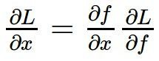
Vectorized operations
f(x) = max(0,x) (elementwise)
Jacobian matrix
4096-d
output vector
4096-d
input vector
Q: what is the size of the Jacobian matrix?

Slide 55
Vectorized operations
f(x) = max(0,x) (elementwise)
Jacobian matrix
4096-d
output vector
4096-d
input vector
Q: what is the size of the Jacobian matrix? [4096 x 4096!]

Slide 56
Vectorized operations
f(x) = max(0,x) (elementwise)
 | in p enti of e
4096-d
input vector
Q: what is the size of the Jacobian matrix? [4096 x 4096!]
4096-d
output vector
ractice we process an re minibatch (e.g. 100) xamples at one time:
i.e. Jacobian would technically be a [409,600 x 409,600] matrix :\
Lecture 4 -

Slide 57
Vectorized operations
f(x) = max(0,x) (elementwise)
Jacobian matrix
4096-d
output vector
Q2: what does it look like?
4096-d
input vector
Q: what is the size of the Jacobian matrix? [4096 x 4096!]
Lecture 4 -

Slide 58
A vectorized example:

Slide 59
A vectorized example:

Slide 60
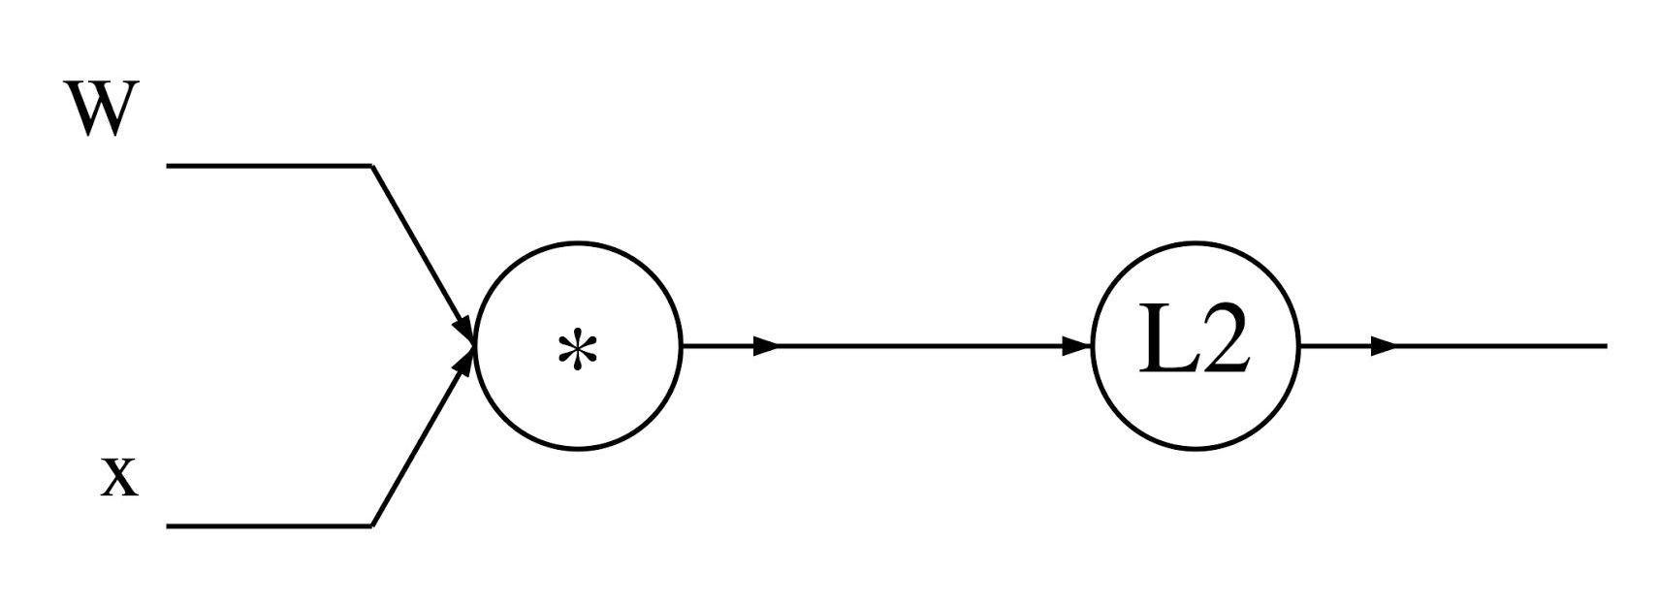
A vectorized example:

Slide 61
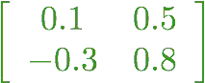
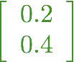
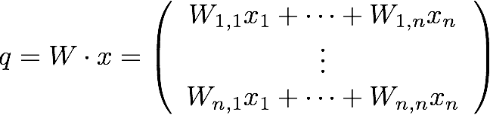
A vectorized example:

Slide 62
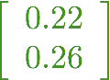
A vectorized example:

Slide 63
A vectorized example:

Slide 64
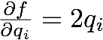

A vectorized example:

Slide 65

A vectorized example:

Slide 66

A vectorized example:

Slide 67



A vectorized example:

Slide 68

A vectorized example:

Slide 69

A vectorized example:

Slide 70
A vectorized example:
Always check: The gradient with respect to a variable should have the same shape as the variable

Slide 71

A vectorized example:

Slide 72


A vectorized example:

Slide 73


A vectorized example:

Slide 74
A vectorized example:

Slide 75

Modularized implementation: forward / backward API
Graph (or Net) object (rough psuedo code)

Slide 76



Modularized implementation: forward / backward API
x
z
*
y
(x,y,z are scalars)

Slide 77

Modularized implementation: forward / backward API
x
z
*
y
(x,y,z are scalars)

Slide 78


Example: Caffe layers
Caffe is licensed under BSD 2-Clause

Slide 79


Caffe Sigmoid Layer
* top_diff (chain rule)
Caffe is licensed under BSD 2-Clause

Slide 80


In Assignment 1: Writing SVM / Softmax
Stage your forward/backward computation!
E.g. for the SVM:
margins

Slide 81
Summary so far...
neural nets will be very large: impractical to write down gradient formula by hand for all parameters
backpropagation = recursive application of the chain rule along a computational graph to compute the gradients of all inputs/parameters/intermediates
implementations maintain a graph structure, where the nodes implement the forward() / backward() API
forward: compute result of an operation and save any intermediates needed for gradient computation in memory
backward: apply the chain rule to compute the gradient of the loss function with respect to the inputs

Slide 82
Next: Neural Networks

Slide 83

Neural networks: without the brain stuff
(Before) Linear score function:

Slide 84

Neural networks: without the brain stuff
(Before) Linear score function: (Now) 2-layer Neural Network

Slide 85
Neural networks: without the brain stuff
(Before) Linear score function: (Now) 2-layer Neural Network
x
h
W1
W2
s
3072
100
10

Slide 86

Neural networks: without the brain stuff
(Before) Linear score function: (Now) 2-layer Neural Network
x
h
W1
W2
s
3072
100
10

Slide 87
Neural networks: without the brain stuff
(Before) Linear score function: (Now) 2-layer Neural Network
or 3-layer Neural Network

Slide 88

Full implementation of training a 2-layer Neural Network needs ~20 lines:

Slide 89

In Assignment 2: Writing a 2-layer net

Slide 90

This image by Fotis Bobolas is licensed under CC-BY 2.0

Slide 91

Impulses carried toward cell body
dendrite
presynaptic terminal
axon
cell body
Impulses carried away from cell body
This image by Felipe Perucho is licensed under CC-BY 3.0

Slide 92

Impulses carried toward cell body
dendrite
presynaptic terminal
axon
cell body
Impulses carried away from cell body
This image by Felipe Perucho is licensed under CC-BY 3.0

Slide 93


Impulses carried toward cell body
dendrite
presynaptic terminal
axon
cell body
Impulses carried away from cell body
This image by Felipe Perucho is licensed under CC-BY 3.0
sigmoid activation function

Slide 94

Impulses carried toward cell body
dendrite
presynaptic terminal
axon
cell body
Impulses carried away from cell body
This image by Felipe Perucho is licensed under CC-BY 3.0

Slide 95
Be very careful with your brain analogies!
Biological Neurons:
Many different types
Dendrites can perform complex non-linear computations
Synapses are not a single weight but a complex non-linear dynamical system
Rate code may not be adequate
[Dendritic Computation. London and Hausser]

Slide 96











Activation functions
Sigmoid
tanh
Leaky ReLU
Maxout
ReLU
ELU

Slide 97


Neural networks: Architectures
“3-layer Neural Net”, or
“2-hidden-layer Neural Net”
“Fully-connected” layers
“2-layer Neural Net”, or
“1-hidden-layer Neural Net”

Slide 98
Example feed-forward computation of a neural network
We can efficiently evaluate an entire layer of neurons.

Slide 99

Example feed-forward computation of a neural network

Slide 100
Summary
We arrange neurons into fully-connected layers
The abstraction of a layer has the nice property that it allows us to use efficient vectorized code (e.g. matrix multiplies)
Neural networks are not really neural
- Next time: Convolutional Neural Networks
Lecture 4 - ¹⁰
0

